Slide 1

MATLAB Cell Arrays
Professor Bo Liu
James Watt School of Engineering

Slide 2
MATLAB cell arrays
MATLAB cell arrays are useful when you want to store data of different data types in the same variable.
Different from tables in that they are not intended to be used for tabular (spreadsheet) data.
Each element in a cell array is a container (cell) that can contain any other datatype
  Even complex data structures like matrices.
Cell arrays can be created like matrices but using curly braces instead of square brackets.
  Or using the cell() function to create an empty cell array
Example creating a cell array:
cell_array = {"five", 5, 5.0, [5, 5, 5]} % last element is a matrix
See live script for similar examples

Slide 3
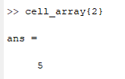
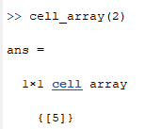
Indexing into cell arrays
Indexing into a cell array using parentheses provides access to the specified cells and returns a cell array.
Indexing into a cell array using curly brackets provides access to the specified cells and returns the contents of the cell.
cell_array{2}
cell_array(2)
cell_array = {"five", 5, 5.0, [5, 5, 5]} % last element is a matrix
See live script for similar examples

Slide 4
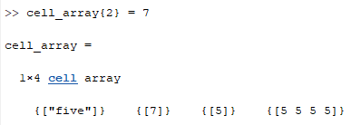

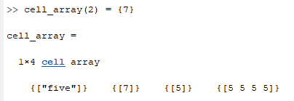
Manipulating cell arrays
Cell arrays can be manipulated in the same way as matrices
  But consider whether you want to modify the cell or its contents
cell_array = {"five", 5, 5.0, [5, 5, 5]} % last element is a matrix
cell_array{2} = 7
cell_array(2) = 7
This gives an error because we are accessing a cell and trying to replace it with a number, fix using curly brackets:
cell_array(2) = {7}
See live script for similar examples

Slide 5
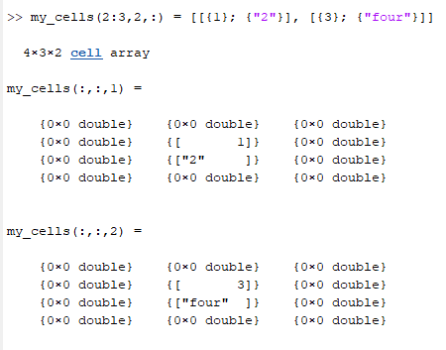
Manipulating multidimensional cell arrays
Creating a cell array of dimensions 4, 3, 2 and changing the central cells to 1, "2", 3, "four":
my_cells = cell(4, 3, 2);
my_cells(2:3,2,:) = [[{1}; {"2"}], [{3}; {“four"}]]
See live script for similar examples

Slide 6
Matrices, tables, cell arrays
MATLAB matrices, tables and cell arrays are similar concepts, but each have their own intended purpose:
  Matrices are used for computation to represent vectors, matrices, or tensors.
    All elements in a matrix should be of the same type.
  Cell arrays are used to group data of different types together.
    Commonly used to store objects, or mixed data types in a single variable.
    Do not support numeric operations such as addition and multiplication.
  Tables are used as spreadsheets for data.
    Used to represent columns of data.
    Do not support numerical operations such as addition or multiplication.
    Allow access to columns and rows via column and row name indexing.

Slide 7




Thanks!
#UofGWorldChangers
@UofGlasgow

